Slide 1
Switch game
Scrum Master: Xin Zhao
Product Manager: Yinuo Huang
Other team members: Yuemin Tang, David Huang, JinFeng Lin

Slide 2
THE CARDS ARE CUT for deal; the player drawing the lowest card is dealer (ace is high). If there is a tie for low, there is another drawing for those who tie. The deal passes to the left after each hand.
The deck is shuffled, and the dealer deals out six rows of cards, each row containing six cards face up. The remainder of the deck is placed aside and is not used during the hand.
The 36 cards dealt on the table should form a square of straight rows and columns, as in the illustration on the next page. Each player places his piece on the card at the left end of the row (or column) nearest him, as in the illustration.

Slide 3
Meetings
3/5
Reformat the game rules
Find some bugs:
the original rule allows give up if you feel you are in unbeatable situation
But that is unclear how to give points to the winning players.
2. If one player gets over 16 points, he can take over his team member’s turn
3/7
Understanding the game rules by exactly playing the card game
Fixed the bugs

Slide 4
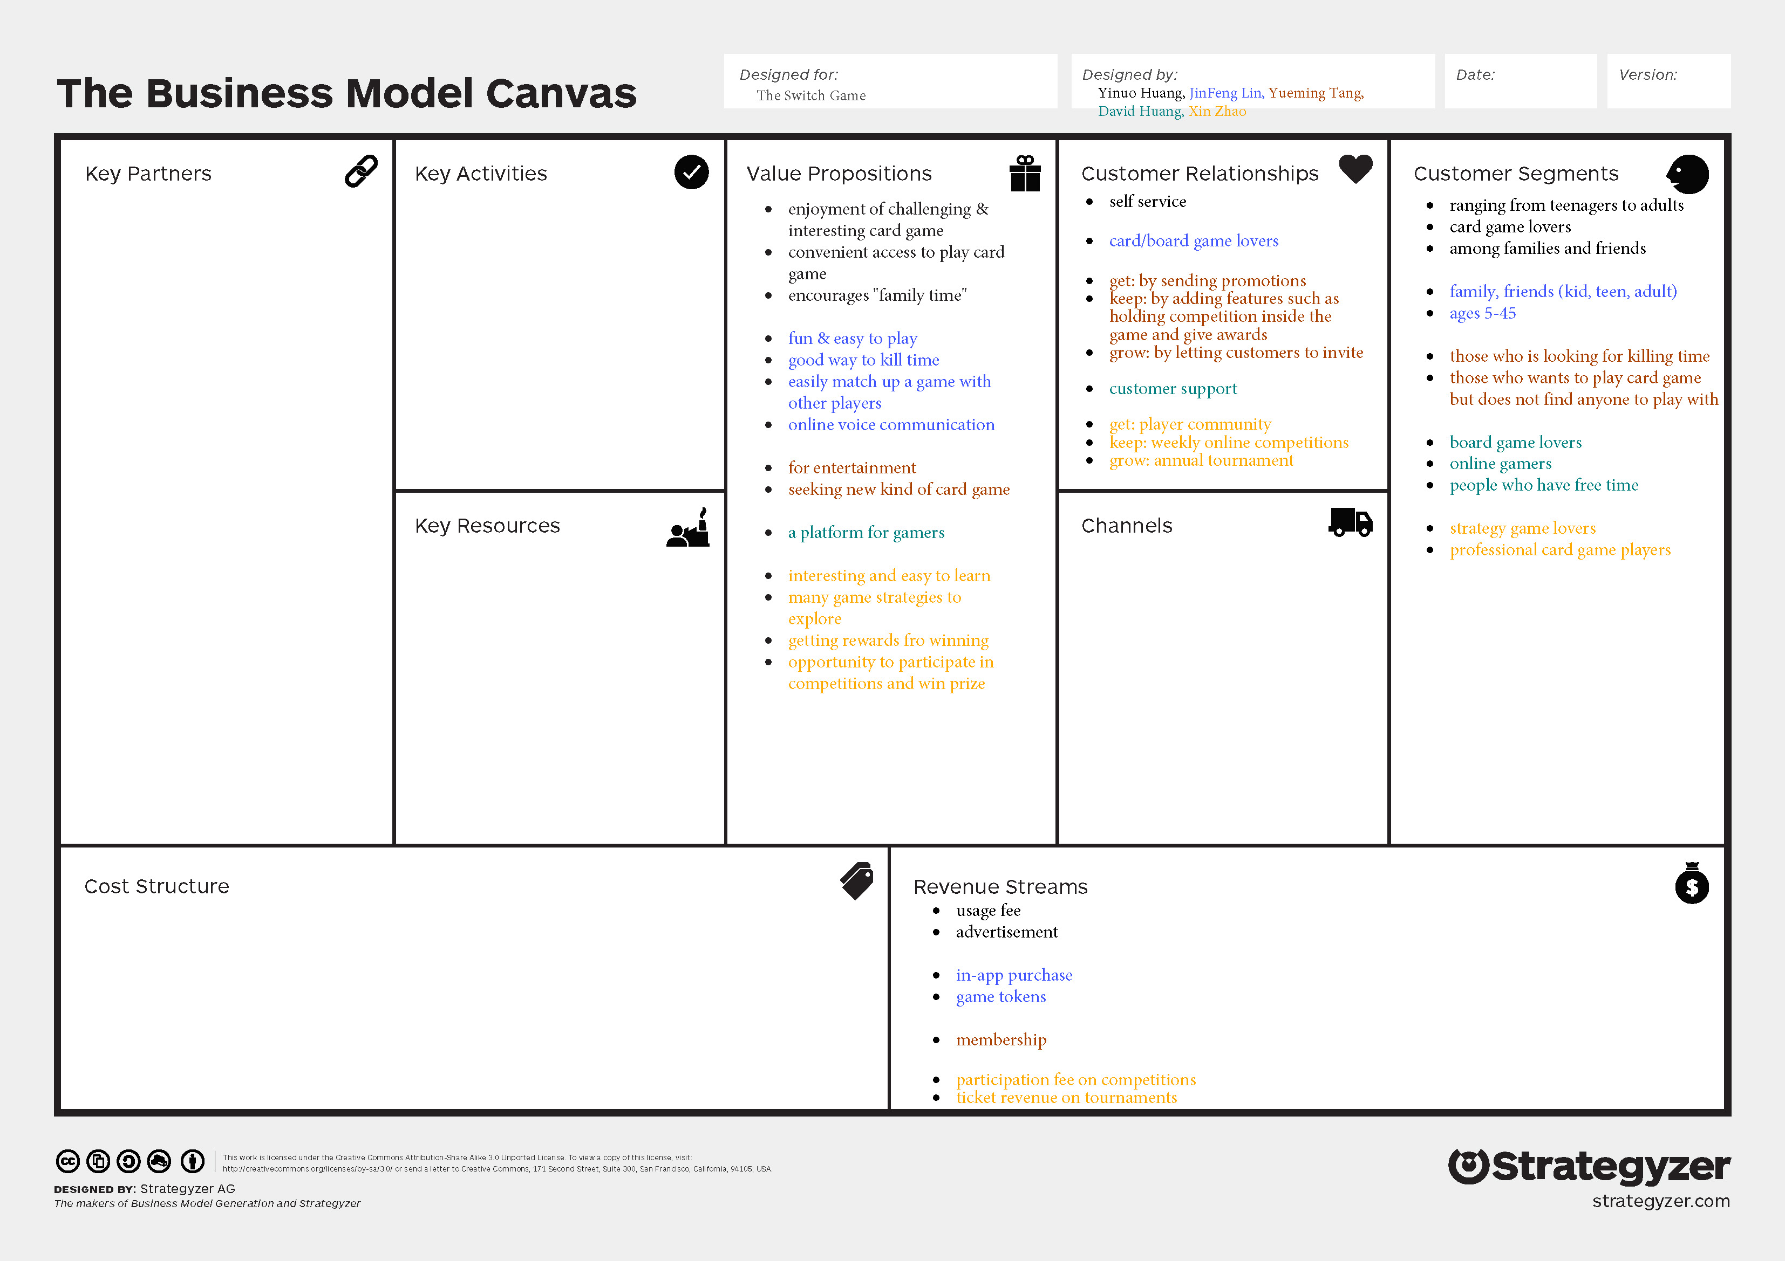

Slide 5


Slide 9
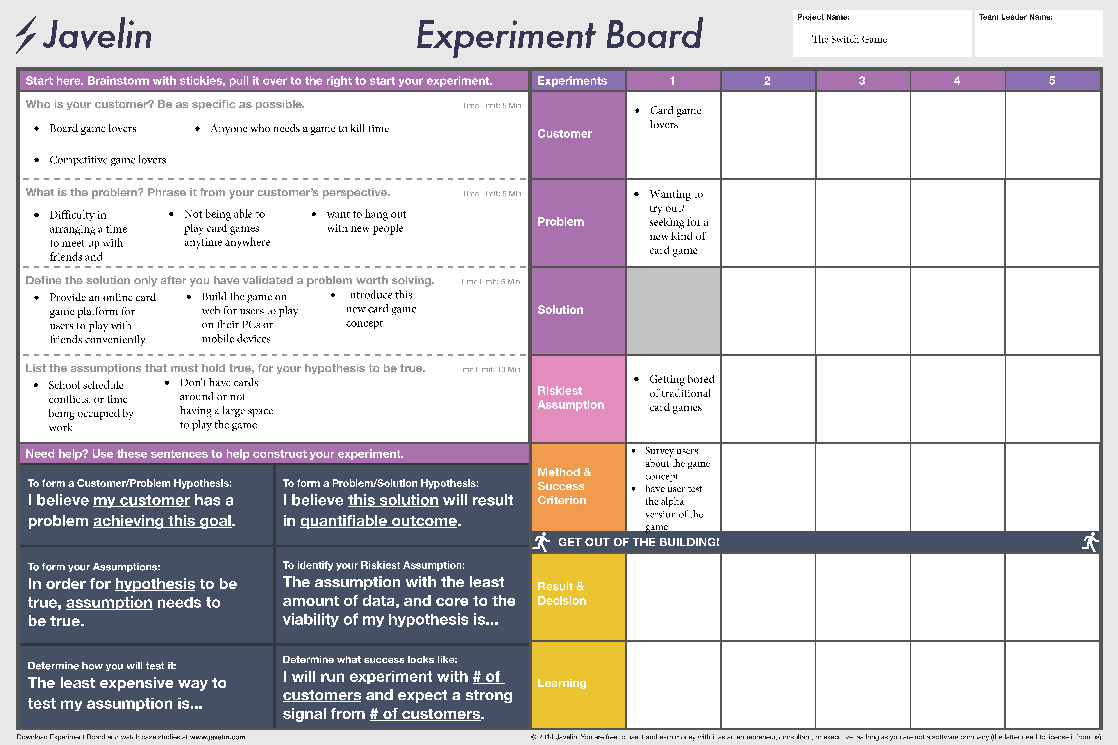

Slide 10
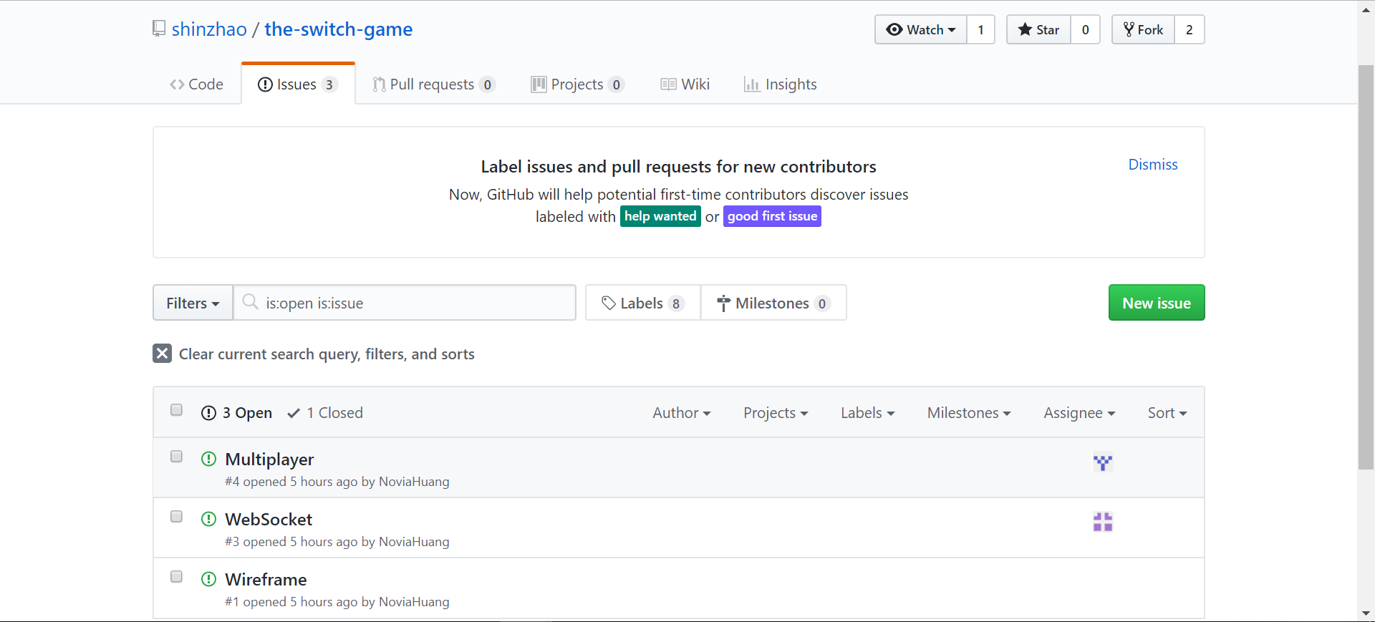
Issues:
Wireframe
Web-socket
Multiple players

Slide 11
